Slide 1
Audio Harmonizer
Urinrinoghene Lauretta Omughelli and Team

Slide 2
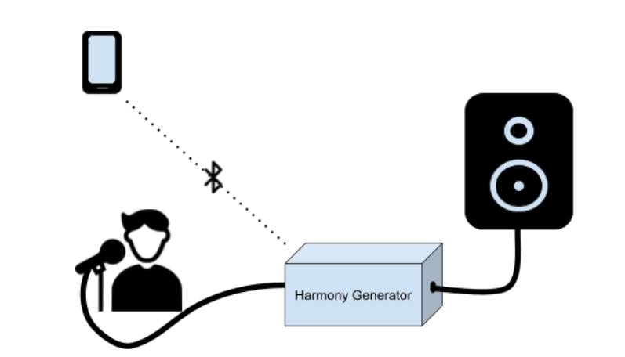
Project Statement
Create a system that allows artists to create multiple harmonies in real time for performances.
Notes:
Jason

Slide 3
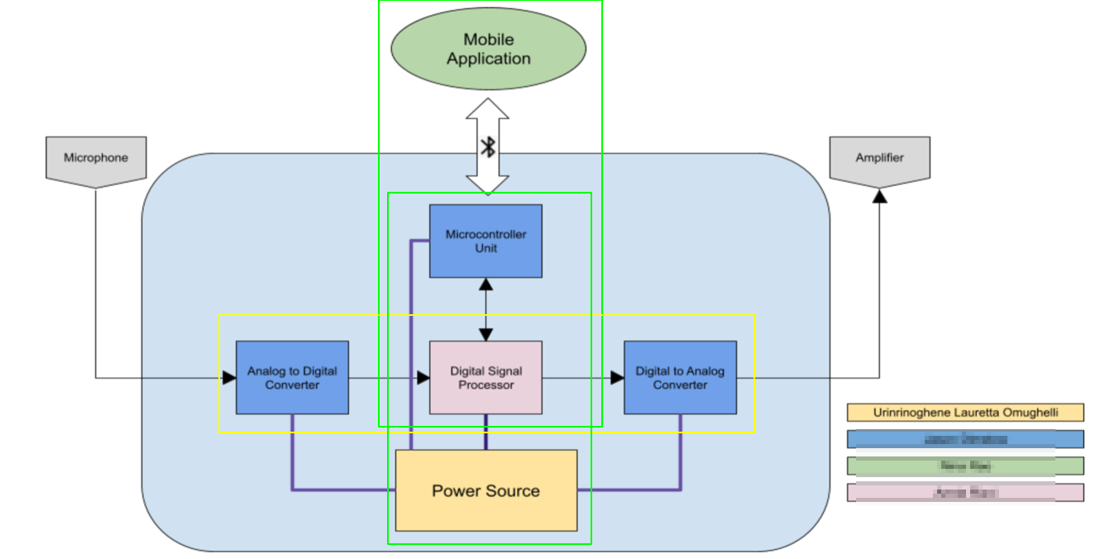
Project Subsystems
Notes:
Nina:

Slide 4
Project Current Timeline
Integrating DSP Algorithms on to Real-Time MCU
MCU and Android Application Bluetooth Communication Complete
Fuel Gauge Integration in Progress

Slide 5
Subsystems

Slide 6
Completed Subsystems
Android Application
Power Supply
MCU

Slide 7
Subsystem 1: Digital Signal Processor
Accomplishments Since 403 <30 hrs> | Ongoing progress/problems and plans until next presentation
Connected with TI Support Sample Project Running Two different avenues available Codec Interrupt Code | Process audio in and Out in Real Time Integrate Harmonies Receive user input from MCU

Slide 8
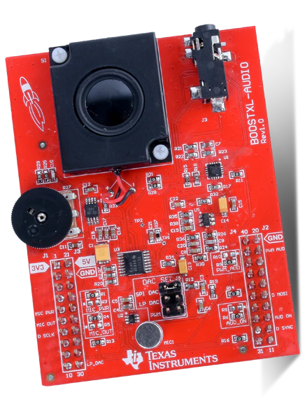
Digital Signal Processor
Electric Guitar Capo Capstone Project
Codec Functions
Project Code Mimics Existing Algorithm
TI Sample Project
Waiting for TI Support
Set up code to take user input from MCU

Slide 9
Subsystem 2: Microcontroller Unit
Accomplishments Since 403 <25 hrs> | Ongoing progress/problems and plans
MCU Testing from last semester complete Communication with App via bluetooth Working on I2C communication with Battery Fuel Gauge | Communication with DSP
Notes:
MCU will be relaying data to and fro the dsp/user interface via bluetooth. Telling the DSP what type of harmony the user wants, and then sending the digital to back to the app...

Slide 10
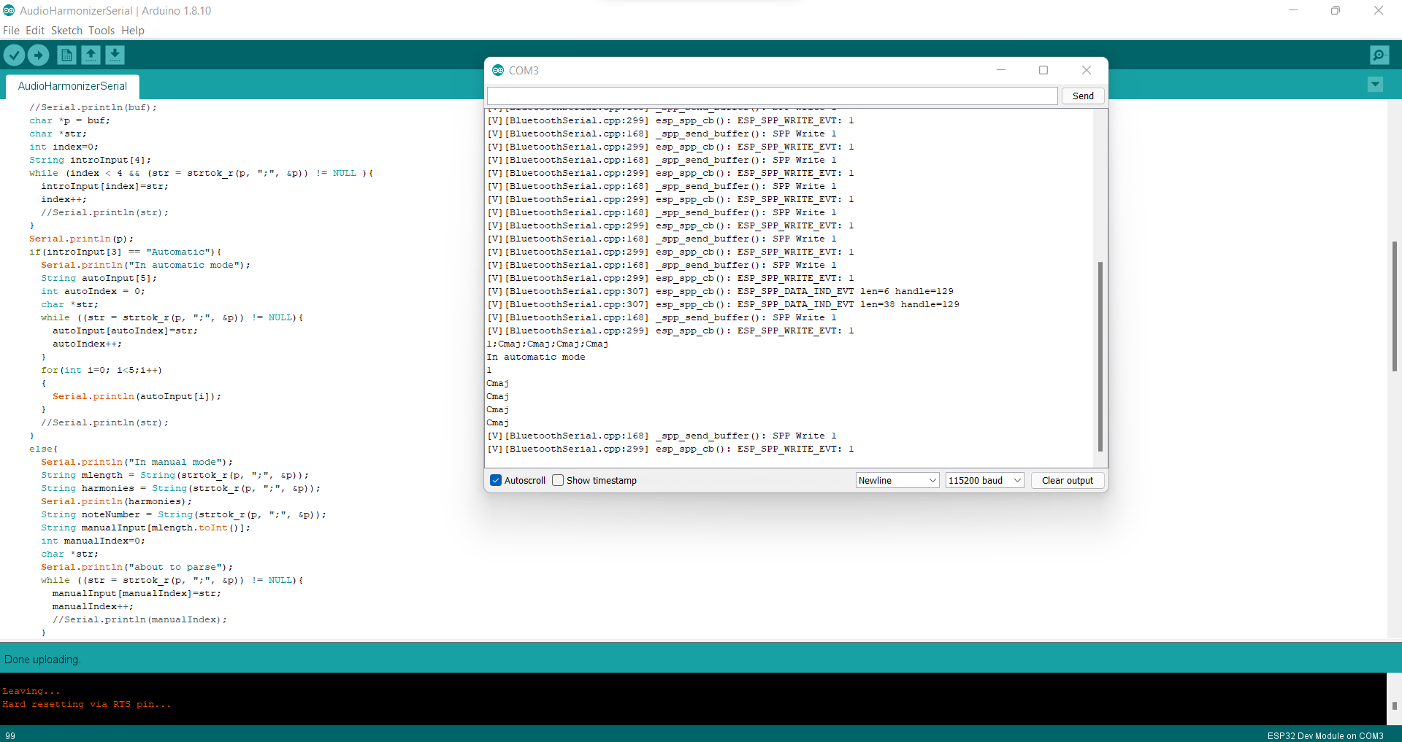
Automatic Mode

Slide 11
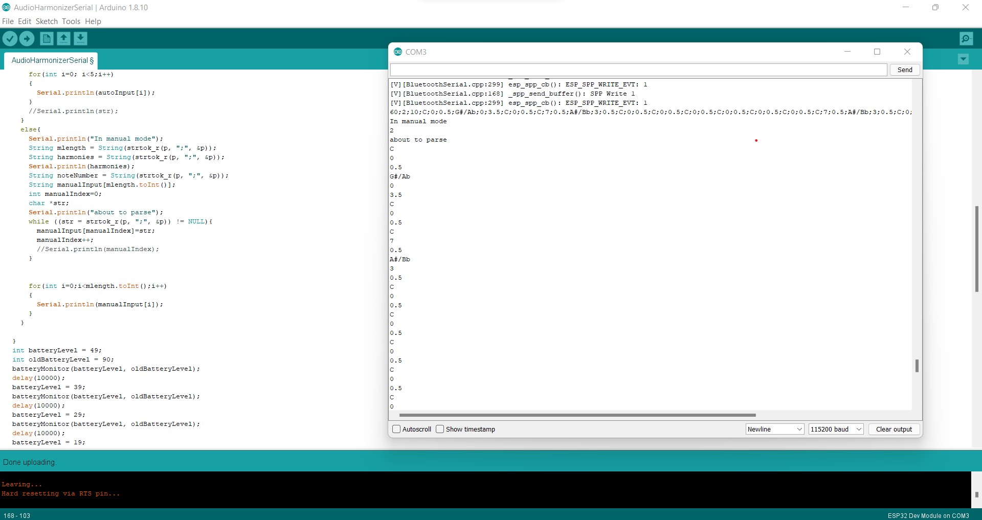
Manual Mode

Slide 12
Subsystem 3: Converters/Main Unit Schematic
Accomplishments Since 403 <0 Hrs> | Ongoing progress/problems and plans until next presentation
Have a physical PCB design from last semester that is now impractical for our use | Waiting for DSP hardware testing and selection to finish PCB manufacturing for DSP/MCU PCB unit
Notes:
24 bits is the optimal bitrate as 32 is unnecessary, 48kHz for HiFi audio, minimum is 40kHz for good audio quality

Slide 13
Subsystem 4: Android Application
Accomplishments Since Last Presentation <25 hrs> | Ongoing progress/problems and plans until next presentation
Working bluetooth communication between ESP32 and Android App Interpret Data from app for the DSP Fixed styling issues | Display battery levels on the app

Slide 14
Subsystem 5: Power Supply
Urinrinoghene Lauretta Omughelli
Accomplishments Since Our Last Presentation <12 hrs> | Ongoing progress/problems and plans until next presentation
Ordered and Received PCB Worked on fuel gauge I2C programming in preparation for Integrating with MCU subsystem | PCB assembly, test, and validate 3.3 V at the output of the converter Test I2C communication with ESP 32

Slide 15
Fuel Gauge Reading
Lauretta & Annie
Arduino Library for BQ27411
Should work with BQ27441
Arduino Code written to read I2C data for:
State of charge
Voltage
Current
Re-test once parts are completely soldered

Slide 16
Bluetooth Communication
Jason & Nina
MCU and Android App Connect via Bluetooth
Android App able to send user inputs as string
MCU Arduino Code able to receive and interpret user input into corresponding variables for manual and automatic modes

Slide 17
Progress

Slide 18
Parts Ordering Status
Main PCB needs to be designed and ordered

Slide 19
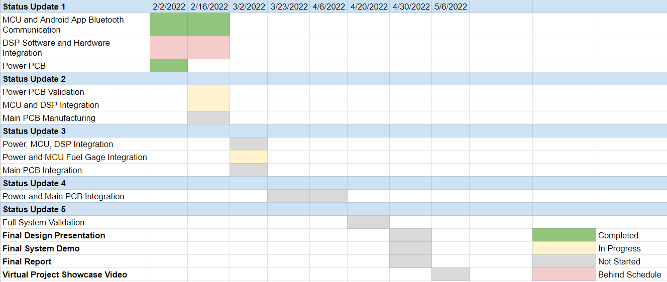
Execution Plan

Slide 20
Questions?

